Slide 1
VISIBLE LIGHT COMMUNICATION(UNDERWATER)
DONE BY:
M.K.CHANDRAVEL(210421106016)
KRISHNA SRIDHAR (210421106046)
S.DEEPAK CHAKKRAWARTHY(210421106019)

Slide 2
OBJECTIVES
To study underwater sea life and its environment.
Energy-efficient communication using visible light.
Helps its deep sea research .
Subsea exploration .
To check health of components and software.
Environmental monitoring.
IOT integration.

Slide 3
IEEE PAPER SURVEY:
International Journal of Engineering Research & Technology (IJERT) ISSN: 2278-0181 Published by, www.ijert.org VIMPACT - 2017 Conference Proceedings
AIP Conference Proceedings 2690(1):020061
DOI:10.1063/5.0121967
Conference: ISET INTERNATIONAL CONFERENCE ON APPLIED SCIENCE & ENGINEERING (CASE 2021)
Haas H, Yin L, Wang Y, Chen C, Journal of Light Technology, 34, 1533–1544 (2016).
Dissanayake SD, Armstrong J, J Light Technology, 31:1063–1072 (2013).
Lv B, Chen Z, Wu T, Shao Q, Yan D, Ma L, et al. The alteration of spontaneous low frequency oscillations
caused by acute electromagnetic fields exposure. Clin Neurophysiol. 125(2), 277–286 (2014).

Slide 4
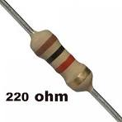
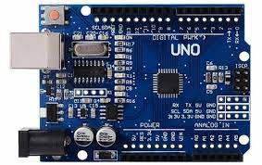
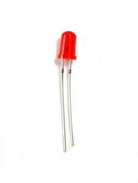
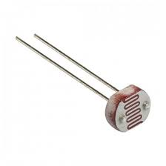
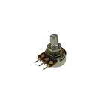
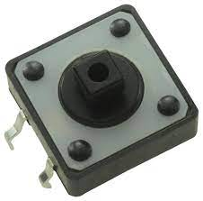
COMPONENTS USED:
Resistor 220 ohm
Arduino UNO
Rotary potentiometer (generic)
LED (generic)
Tactile Switch, Top Actuated
LDR 5M ohm
Medium (Water to transmit and receive)

Slide 5
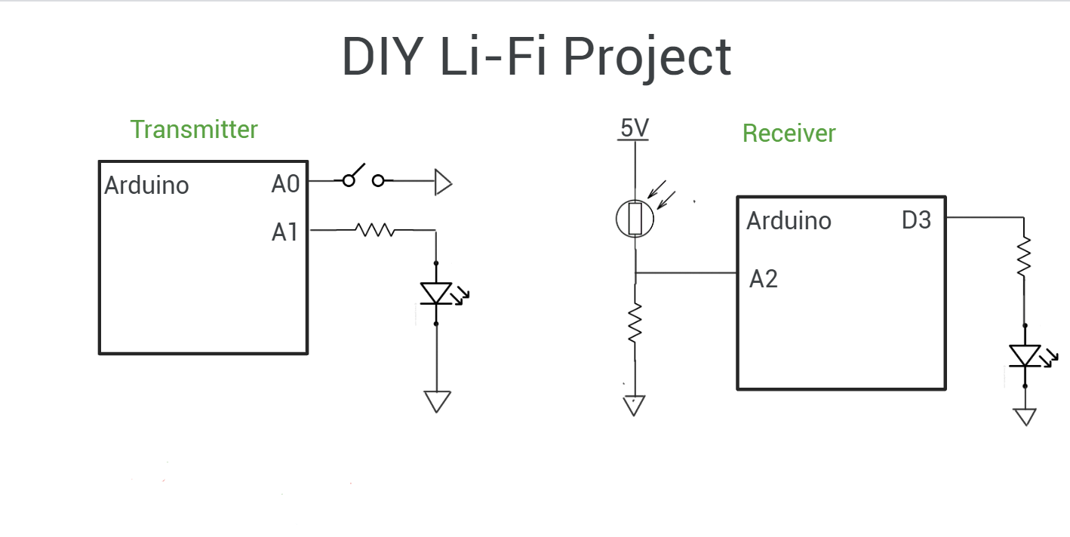



Slide 6
FUTURE SCOPES OF VLC
Subsea Exploration and Research:
Li-Fi can enhance communication capabilities for subsea exploration and research missions.
Underwater Monitoring and Surveillance:
Li-Fi technology can be applied in underwater surveillance systems for monitoring marine life
Environmental Monitoring:
Li-Fi can play a crucial role in monitoring environmental conditions in oceans and water bodies

Slide 7
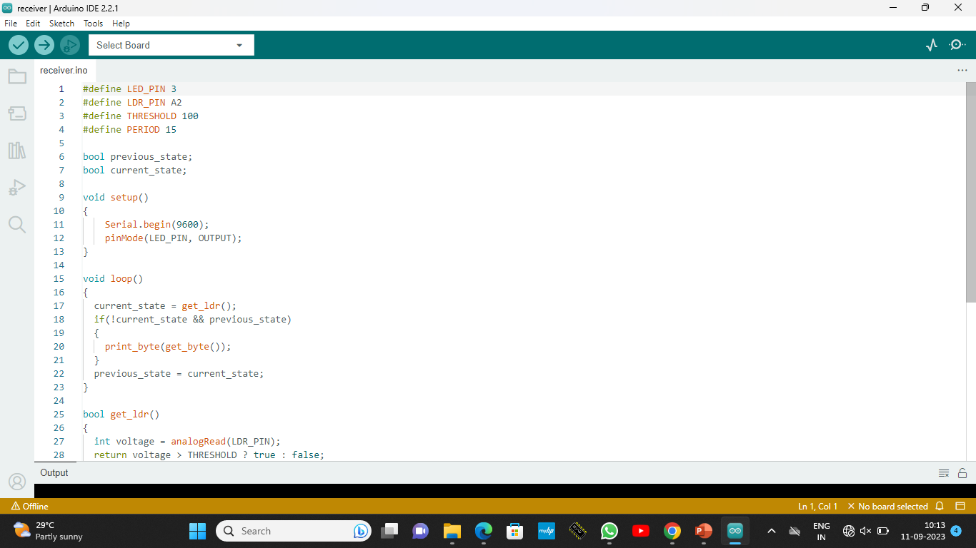
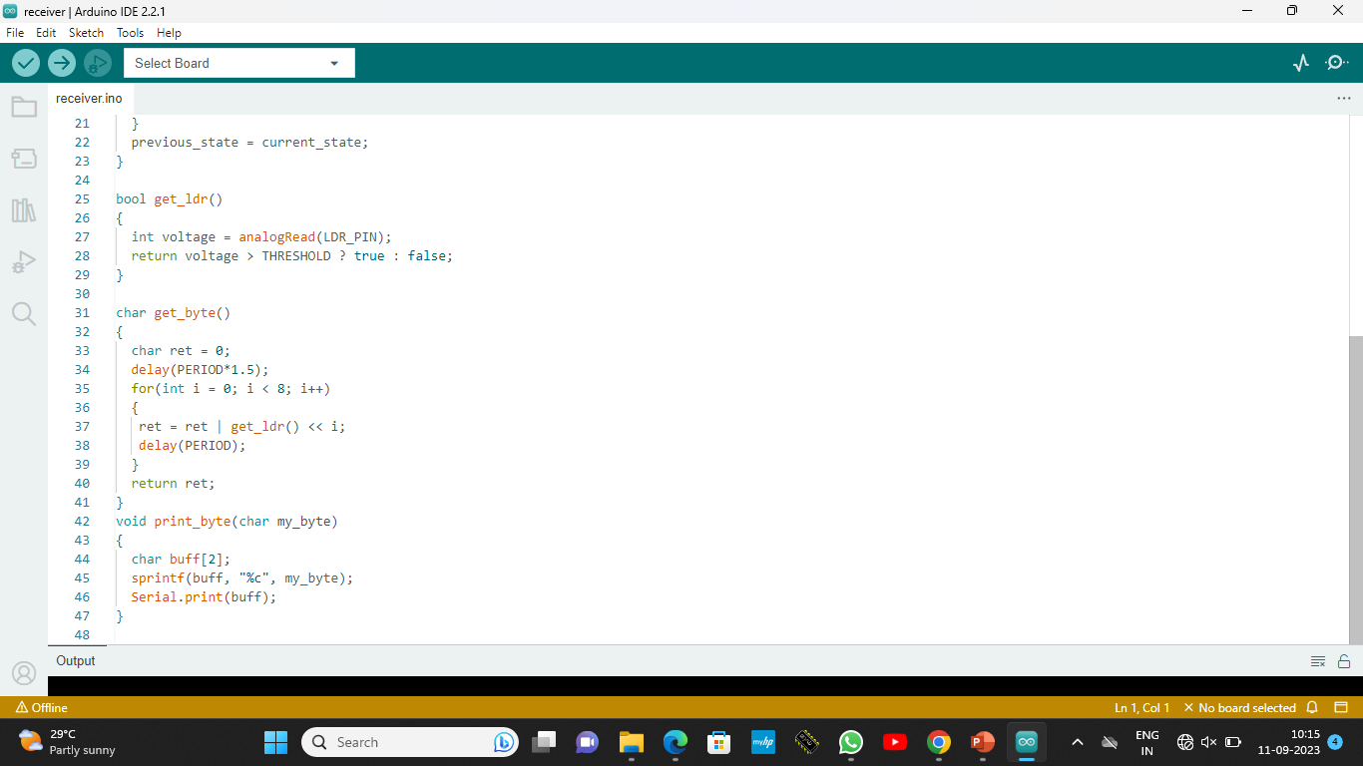
Receiver code:

Slide 8
Transmitter code:
#define LED_PIN A1
#define BUTTON_PIN A0
#define PERIOD 15
char* string = "This is a test transmission";
int string_length;
void setup()
{ pinMode(LED_PIN, OUTPUT);
//pinMode(BUTTON_PIN, INPUT_PULLUP);
string_length = strlen(string);}
void loop()
{
for(int i = 0; i < string_length; i ++)
send_byte(string[i]);
delay(1000);
}

Slide 9
Transmitter code
void send_byte(char my_byte)
{ digitalWrite(LED_PIN, LOW);
delay(PERIOD);
//transmission of bits
for(int i = 0; i < 8; i++) {
digitalWrite(LED_PIN, (my_byte&(0x01 << i))!=0 );
delay(PERIOD);
}
digitalWrite(LED_PIN, HIGH);
delay(PERIOD);
}

Slide 10
Receiver Code
#define LED_PIN 3
#define LDR_PIN A2
#define THRESHOLD 100
#define PERIOD 15
bool previous_state;
bool current_state;
void setup() {
Serial.begin(9600);
pinMode(LED_PIN, OUTPUT);}
void loop() {
current_state = get_ldr();
if(!current_state && previous_state)
{ print_byte(get_byte());
}

